Slide 1
Blockchain
Ernesto Lee

Slide 2
Let’s start by checking to see if any of your accounts have been compromised…
Open a browser and go to:
https://haveibeenpwned.com/
Download this file and execute the commands:
https://github.com/fenago/advblockchain/blob/master/PreReq_Setup.docx

Slide 3

How can data be stored?
Plain text
Encryption
Hashing

Slide 4
Plain Text
Would you store passwords in this format?
Would a company store passwords in this format?
What about other data? Plain text or no?
Username | Password
Ernesto | qwerty
Kimberly | Asdgjkl;
Jordan | BarryUniversity#1
Notes:
https://motherboard.vice.com/en_us/article/7xdeby/t-mobile-stores-part-of-customers-passwords-in-plaintext-says-it-has-amazingly-good-security
https://gizmodo.com/github-tells-some-users-it-accidentally-stored-their-pa-1825702783
https://github.com/plaintextoffenders/plaintextoffenders/blob/master/offenders.csv
https://v3rmillion.net/showthread.php?tid=521496 // neopets breach… 26 million

Slide 5
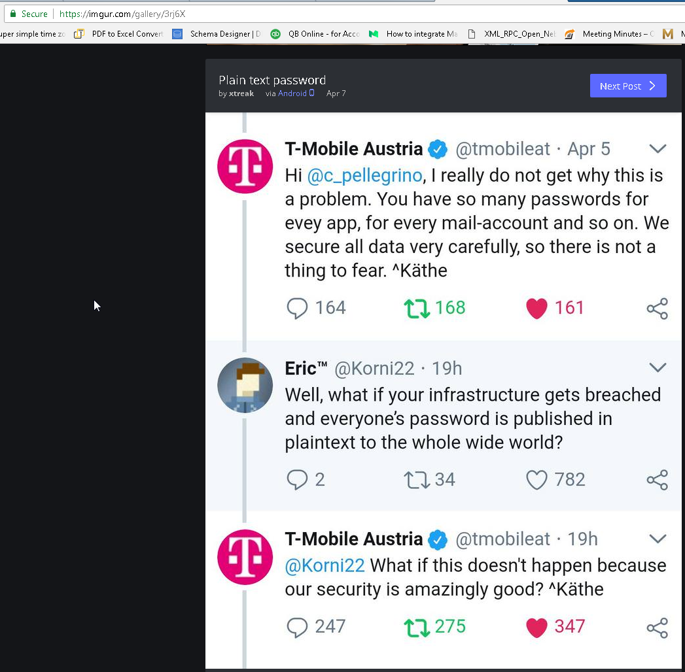
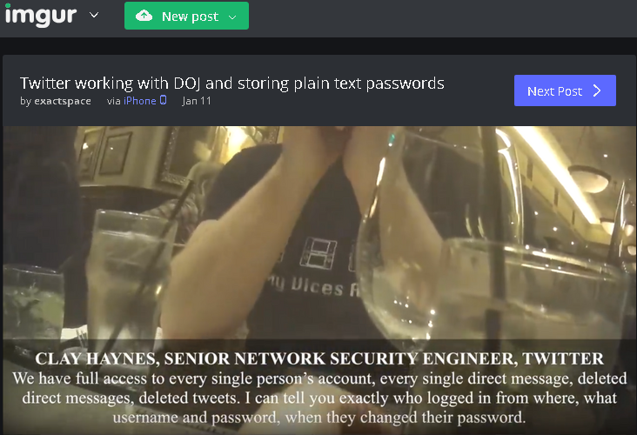
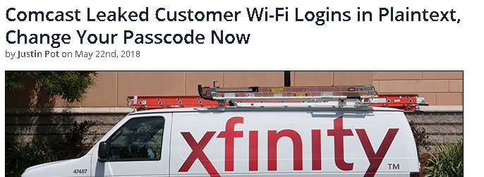

Slide 6
Type Free Web Hosting into Google…
Find 000Webhost
It has 13.5 Million Users
All 13.5 Million Usernames and Passwords are available on the open internet and the credentials are all in plain text.
Let’s just say… nah… this ain’t good
Notes:
https://www.forbes.com/sites/thomasbrewster/2015/10/28/000webhost-database-leak/#bd008a960988

Slide 7
No to Plain text… what about Encryption?
Instead of storing passwords in clear text.
What if you encrypted the password before storing it with an encryption key? What are some issues with this?
Username | Password
Ernesto | qwerty
Kimberly | Asdgjkl;
Jordan | BarryUniversity#1
Username | Password
Ernesto | qwerty -> a;jfkdj83==
Kimberly | Asdgjkl; -> ouirthgn=
Jordan | BarryUniversity#1 -> ahflaf==
Notes:
The issues are that under the encryption layer… there is still a plain text password.
Also, encryption is designed to be a 2 way street. If the private key is compromised… so is your password.

Slide 8

Encryption Problems…
Issues with Encryption
If a hacker gets the key then the hacker gets the clear text password
Encryption is designed to be a TWO WAY algorithm
It is designed to SHARE data with security during transport
This is NOT good for all use cases however (like passwords)

Slide 9

Hashes
Hash Properties
A Hash is a ONE WAY algorithm
It takes TEXT and returns a UNIQUE string of a FIXED length
sha1-online.com
Ernesto Lee lives in Florida
SHA1=fe9517321fc94f6687d3c4aeb03b1d659a6d134e
SHA256=ae716375c88157d50731b4633a93afa61bef1c31f927d548d6930b2126537383
Notes:
To test this – go to passwordsgenerator.net/sha256-hash-generator/ and put in Ernesto Lee lives in Florida and validate
You can calculate the HASH of a password but you can not calculate the password from a HASH

Slide 10
One way property of Hashes
Password 🡪 Hash but NEVER Hash 🡪 Password
Or said more broadly
Data 🡪 Hash but NEVER Hash 🡪 Data
This means that if you challenge someone to see if they know the password OR if they have the original data – you do not need to be presented with the password or the original data… only the HASH of the password or the original data.
This is a key point for understanding WHY hashes are important for passwords as well as why hashes are important for Blockchain.

Slide 11
Hashing Problems…
Hashing Algos or usually optimized for speed.
The more Hashes / Second that can be calculated by the algorithm – the better
This optimization makes Hashing Algorithms vulnerable for BRUTE FORCE ATTACKES (quantum computing?)
Said another way – Hash(xzy) = KNOWN_Hash … no… then let’s try
Hash(xyA) = KNOWN_Hash … etc.
We are counting on the limitations of existing computing power to prevent a hacker from simply going through all known data inputs
To see the “hashing power” of modern GPU and ASIC hardware:
https://www.nicehash.com/profitability-calculator
Notes:
Nvidea GeForce GTX970 = 292,000,000 Hashes / Second

Slide 12
Hashing Problems Continued…
Rainbow Tables
Lists of commonly used passwords that have already been hashed and have a known hash
Go to: sha1-online.com and use SHA256 to hash the word: Ernesto
b2d45c1ee39ac25da7e9d1390a2552afec419af398f405d673917bd2f9bd2eb8
Go to: crackstation.net and enter the HASH from above … was it able to crack your password?
Search for the top 10 commonly used passwords and hash each of them and confirm if they are already in the Rainbow tables database at crackstation.net
Shared passwords
If I have a list of hashed passwords then I can tell if the passwords are shared
What if I want to confirm that the data that you have in your node is the same as the data I have in my node?
Notes:
123456
Password
12345678
Qwerty
12345
123456789
Letmein
1234567
Football
iloveyou

Slide 13

How do we fight Rainbow tables?
Salt
We need a way to randomize the data in addition to the data
Salt… salt is a piece of random data that is added to the file to ensure uniqueness.
Hash(data + salt)
Hash(qwerty + h87f) = Hash1
Hash(qwerty + 9vTy) = Hash2
**Unique hashes even though the DATA is the same
This SLOWS down brute force attacks.
Notes:
Nonce = Salt
So even if a password account is compromised – then all of the passwords that are the same are not compromised. If one password is hacked due to a brute force attempt then the hacker has to start all over again to hack an identical password.

Slide 14

How do we fight Brute Force Attacks?
bcrypt, scrypt, argon2
Hash(data, salt, cost)
This generation of algorithms take input data and provide a salt AND they iterate over the algorithm numerous times – effectively slowing down brute force attacks
As computers get stronger – we simply increase the cost to counteract the brute force strength – we use quantum computing to counteract quantum computing
Notes:
A salt is random text added to the string to be hashed. For example, you don't hash my_secret_password; you hash something like 1jfSLKe$*@SL$#)(Sslkfs$34:my_secret_password. The reason for this is that it makes it hard to set up a "rainbow table" to brute-force the passwords, even if the entire database of hashed passwords is stolen. If every password has a different salt, only the very weakest passwords (like "password" or "123456", which you should prohibit anyway) will be guessed.
A cost is a measure of how many times to run the hash -- how slow it is. You want it to be slow. Again, this is a redundant layer of security for if the hashed passwords are stolen. It makes it prohibitively expensive to brute-force anything.
You can read a good description here: https://security.stackexchange.com/a/51983/35405
NAME
argon2 - generate argon2 hashes SYNOPSIS
argon2 salt [OPTIONS] DESCRIPTION
Generate Argon2 hashes from the command line. The supplied salt (the first argument to the command) must be at least 8 octets in length, and the password is supplied on standard input. By default, this uses Argon2i variant (where memory access is independent of secret data) which is the preferred one for password hashing and password-based key derivation. OPTIONS
-h Display tool usage -d Use Argon2d instead of Argon2i (Argon2i is the default) -id Use Argon2id instead of Argon2i (Argon2i is the default) -t N Sets the number of iterations to N (default = 3) -m N Sets the memory usage of 2^N KiB (default = 12) -p N Sets parallelism to N threads (default = 1) -l N Sets hash output length to N bytes (default = 32) -e Output only encoded hash -r Output only the raw bytes of the hash
git clone https://github.com/P-H-C/phc-winner-argon2.git
cd ./phc-winner-argon2
sudo make install
./argon2

Slide 15
Let’s look at how to get to the top of the mountain…
Password 🡪 Hash
Use argon2 (or scrypt or bscrypt or crypt) to hash the hash over numerous iterations
Take the output argon2 hash and ENCRYPT that
Make sure that the private key for this is not stored locally and is itself under trusted lock and key
This is the case for each credential or data set. The computing power required to crack this is now asymptotic.
In other words, the computing power required to hack is likely more costly than the data itself

Slide 16
Now… let’s Blockchain
BLUF: Bottom Line Up Front
A blockchain is a chain of blocks with data in each block.
The data in the blocks are tamper proof thanks to cryptography
A blockchain is also known as a Distributed Ledger Technology
A public blockchain is completely open to anyone (transparent)

Slide 17
Blocks
Let’s start by looking at a single BLOCK in a BLOCKCHAIN
Each block has the following:
Data
Hash
Hash of the Prior Block

Slide 18
Block: Data
What is the “data” that is stored in the blockchain?
It depends on the blockchain
LiteCoin and BitCoin (and others) simply have
Data = From, To, Amount and the implied asset is cryptocurrency
Generation 2 blockchains can do the following:
A custom calculation (Smart Contract) is used to generate what is stored
Data = From, To, Amount, Custom_Data
the implied asset is cryptocurrency AND custom assets
Generation 3 blockchains can do the following:
Custom Calculation (Chaincode)
No cryptocurrency
All custom assets
Data = ANY CUSTOM DATA

Slide 19
Lab 1 – create a block
Please use any python editor but I recommend:
http://repl.it
***choose NodeJS language from the bottom
cd ~/ErnestoCoin/
git clone https://github.com/fenago/advblockchain/blob/master/lab1_main.js

Slide 20

Block: Hash
Every block has a hash
A Hash can be thought of as a fingerprint. It is effectively the unique identifier for the block itself AND the data in the block.
Once a block is created, its contents are hashed. Therefore, changing something inside the block will cause the hash to change.
Hashes are critical to detect changes inside of blocks OR to determine if all nodes on a blockchain contain the SAME data

Slide 21
Block: Hash
Every block contains the hash of the prior block
This is what “chains” the blocks together to give us the “Blockchain”
This is also what makes the blockchain so secure since you now have a tamper-proof scheme that extends node boundaries

Slide 22
Genesis Block
The first block does not have a predecessor so it can not point to the “prior hash”.
This also means that the first block must be manually created

Slide 23

Demo
https://anders.com/blockchain/blockchain.html
Put data into each of the 5 blocks and notice that the new hash contains the prior hash
Go in order and select the “mine” button one at a time (from left to right)
Wait until the first block finishes mining before mining the next block
Once ALL of the blocks have been mined – go into block 2 and change the data… what happens and why?
Also, to see how keys, signatures, transactions, and blockchains work – go here:
https://anders.com/blockchain/public-private-keys/keys.html

Slide 24
Using Hashes is not enough…
Modern computers can calculate million of hashes per second
This means that you could tamper with the data in a block AND then recalculate the hashes of the entire blockchain.
This would provide a logically valid blockchain where each hash is connected to its NEWLY computed hash
This is a serious weakness.

Slide 25

How do we slow down the creation of new blocks?
Proof of Work
It’s purpose is to slow down the creation of new blocks
You force the network keepers to solve a riddle related to the hash before a new block can be added to the chain
You can include a “difficulty in this riddle (i.e.: BTC takes 10 min to solve)
If one block is tampered with and the hash is recalculated, you have to recreate the proof of work of ALL of the other blocks as well (10 min per block in BTC)
Notes:
The power in blockchain comes from hashing and the creative uses of Proof of Work algorithm

Slide 26

Another self healing security principle…
Blockchains inherit native security by being distributed via a peer to peer network. Hence, blockchain is a NETWORK
In a public blockchain, anyone can join (not private bc’s obviously)
Anyone (in public or private) blockchains, join the network – they get a complete copy of the chain.
A node can use this to validate the “correctness” of the blockchain

Slide 27
New Block created in a P2P scenario…
A new block is created and sent to every node on the network
Each node validates the block hashes to ensure no tampering
If all is good – each node adds the block to their copy of the blockchain
All the nodes create consensus. They agree which blocks are valid and which are not
Blocks that are tampered with are REJECTED

Slide 28
To hack the blockchain
You need to tamper every block on the chain
You need to redo the POW for each block
You need to take control of 50% of the blocks on the network
Only then will your new blocks (or tampered data) be accepted by the network
This has so far been proven impossible to do

Slide 29
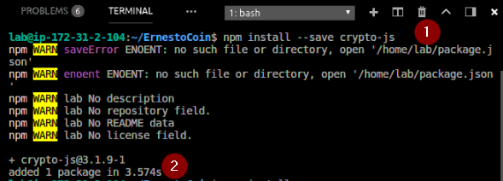

Slide 30
Lab 2 – Create the Hash
cd ~/ErnestoCoin
git clone https://github.com/fenago/advblockchain/blob/master/lab2_main.js
Solution:
git clone https://github.com/fenago/advblockchain/blob/master/lab2_solution_main.js
node lab2_solution_main.js // this will run the solution
Notes:
https://github.com/fenago/advblockchain/blob/master/lab2_solution_main.js

Slide 31
Lab 3 – create the blockchain
cd ~/ErnestoCoin/
git clone https://github.com/fenago/advblockchain/blob/master/lab3_main.js
Solution:
git clone https://github.com/fenago/advblockchain/blob/master/lab3_solution_main.js
node lab3_solution_main.js //this will run the solution

Slide 32
Lab 4 – get the last block and create a block
cd ~/ErnestoCoin
git clone https://github.com/fenago/advblockchain/blob/master/lab4_main.js
Solution:
git clone https://github.com/fenago/advblockchain/blob/master/lab4_solution_main.js
node lab4_solution_main.js //this will run the solution

Slide 33
Lab 5 – is the blockchain valid?
cd ~/ErnestoCoin/
git clone https://github.com/fenago/advblockchain/blob/master/lab5_main.js
Solution:
git clone https://github.com/fenago/advblockchain/blob/master/lab5_solution_main.js
node lab5_solution_main.js //this will run the solution

Slide 34
Lab 6 – PoW
cd ~/ErnestoCoin/
git clone https://github.com/fenago/advblockchain/blob/master/lab6_main.js
Solution:
git clone https://github.com/fenago/advblockchain/blob/master/lab6_solution_main.js
node lab6_solution_main.js //that will run the solution

Slide 35
Lab 7 – CryptoEconomics
cd ~/ErnestoCoin/
git clone https://github.com/fenago/advblockchain/blob/master/lab7_main.js
*solution can be found by:
git clone https://github.com/fenago/advblockchain/blob/master/lab7_solution_main.js
node lab7_solution_main.js //that will run the solution

Slide 36
What have we accomplished?
We have built a block
What Next?
Make the blockchain distributed
Further harden the blockchain
We have implemented a cryptocurrency
We have built a blockchain
We have implemented a Proof of Work Algorithm

Slide 37
Smart Contracts
The term derives from: Nick Szabo (Computer Scientist and Legal Scholar)
He simply wanted to use a distributed ledger to store contracts

Slide 38
Smart Contracts
Smart contracts are exactly like “paper” contracts with the exception being that they are obviously software
These contracts are simple programs that are stored on the blockchain
Smart contracts can custom code different types of assets. In other words, it can provide custom structure around a transaction

Slide 39
Use Case
Uber is a ride sharing platform
Customers can go to Uber, request a ride, and wait to be picked up
Uber is a THIRD PARTY that sits between Riders and Drivers
This means that both RIDERS and DRIVERS must TRUST Uber in order for the platform to work. Specifically, the trust Uber to handle their money correctly
If a ride is successfully given, then Drivers expect to be given their money. Likewise, Riders expect the money to go to the drivers if a ride is successful, or be provided a refund.
Trust is required in this model…
With Blockchain, you can build the same business model but without a Third Party in the middle

Slide 40

Use Case Implementation
A smart contract is created to:
Hold the funds until a goal (a successful ride) is reached
Riders will transfer their money to the smart contract which holds the money in escrow
Once a ride is complete, the smart contract automatically passes the money to the Driver or it will send it back to the Rider
Both Riders and Drivers are FREE EVALUATE THE CODE IN THE SMART CONTRACT AND THE HISTORY OF ALL TRANSACTIONS

Slide 41
Why Trust a Smart Contract
The code is IMMUTABLE
Once written and deployed, the code can not be modified
The code is DISTRIBUTED
The output of your contract is validated by ALL parties on the blockchain network
This means that a single node (or person) can not force funds to be given to drivers prematurely or refunds given unfairly because the entire network validates
The code is TRANSPARENT
So all parties can be provided the opportunity to see the actual code
Notes:
Crowdfunding / ICO Banks: Loans/Automatic Payments
Insurance: Process Claims
Postal: Payment on Delivery
Food Safety:
Security: Mark bad IPs

Slide 42
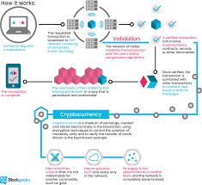
Blockchain Life-cycle

Slide 43

Questions?

